Slide 1
Week 11 - Security
CPAN 212 – Modern Web Technologies

Slide 2
Agenda
Implement security features in NodeJS
Web Security
CORS
HTTPS
Deployment

Slide 3
Web App Security
What is it?
AAA
Accounting DB table -> users, Register()
Authentication -> Who are you, Login()
Authorization -> what can you do? What resources do you have access to?
To ensure we have AAA
http -> https -> certification
DB users: use password encryption (like bcrypt.js)
Session Management

Slide 4
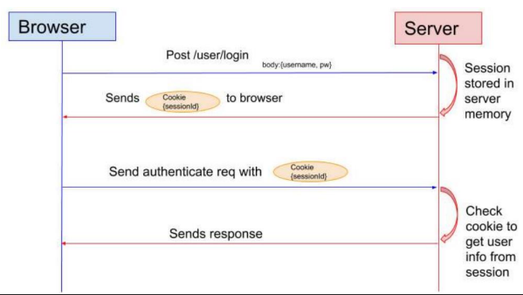
Web App Security: Session
When you open a webpage for the first time, it might ask you to login login > session created on server > encryption > cookie > save in users' browser by using client-session.js

Slide 5
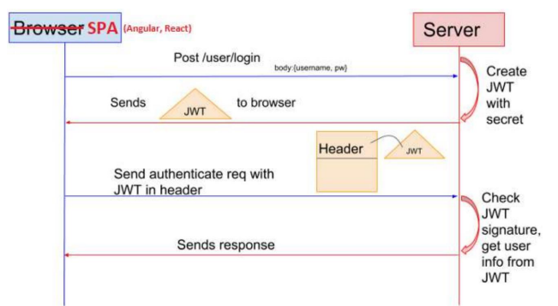
Securing a Web API
JWT (JSON Web Token)
Authentication using a token stored on your browser
Similar to sessions but for web Apis

Slide 6
Issues behind Traditional Systems
Sessions: Record needs to be stored on server
Scalability: With session in memory, load increases drastically in distributed system
CORS: When using multiple devices grabbing data via AJAX requests, we may run into forbidden requests.
CSRF Attacks: Riding session data to send commands to server from a browser that is trusted via session.

Slide 7

ACCESS CONTROL
Anonymous users should not have complete access to all resources
Users should only have delete/update access to resources they create
Restrict adding resources to logged in users
Restrict updating and deleting resources to users that created them

Slide 8
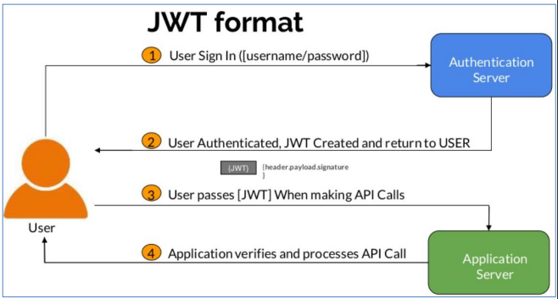
What is JWT
https://jwt.io/
Compact and self-contained way for securely transmitting information between parties as a JSON object

Slide 9
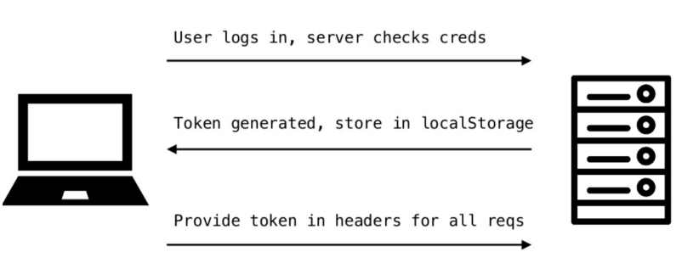
JSON web Tokens
A JSON web token, or JWT (“jot”) for short, is a standardized, optionally validated and/or encrypted container format that is used to securely transfer information between two parties

Slide 10
WHEN TO USE JSON WEB TOKENS
Authorization: Once the user is logged in, each subsequent request will include the JWT, allowing the user to access routes, services, and resources that are permitted with that token
Information Exchange: JWTs are a good way of securely transmitting information between parties. Because the signature is calculated using the header and the payload, you can also verify that the content hasn't been tampered with
Consists of 3 parts separated by a dot.
Header
Payload
Signature
xxxxx.yyyyy.zzzzz
Three JSON arrays encoded with Base64Url and concatenated with a . (dot)
When the user wants to access a protected resource they pass the token in the Authorization header in the Bearer schema

Slide 11
CROSS-ORIGIN RESOURCE SHARING (Remember CORS)
CORS allows restricted resources on a web page to be requested from another domain outside the domain from which the first resource was served
Defines a standard for how the browser and server can interact
More freedom and functionality than same origin requests
Allows front-end frameworks like React and Angular to make requests to backend from different domains
Can be used per route or on all routes

Slide 12
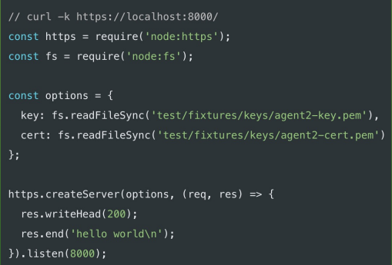
Hyper Text Transfer Protocol Secure (HTTPS)
Extension of HTTP
Encrypted using Transport Layer Security (TLS) or Secure Sockets Layer (SSL)
Protection of credentials during authentication
Ensures privacy and integrity of exchanged data while in transit
Defends against man-in-the-middle attacks and eavesdropping
Defends against man-in-the-middle attacks and eavesdropping
Requires a trusted third party to sign a server-side digital certificate
Initially was used mainly for secured payment transactions
Campaign by Electronic Frontier Foundation in 2016 helped make it prevalent
Now more widely used than HTTP

Slide 13
Deployment
There are MANY ways to get your apps un and running for other people to see
We will be using Vercel because it provides you enough to get your applications going without additional hassles
Let's go and deploy!

